Slide 1
FPGA - Project Installation With Creation Of Bit file
Installation of the previous year TIFR-FCRIT FPGA project
Creation done using both Vivado 2018.2 and Vivado 2019.1

Slide 2
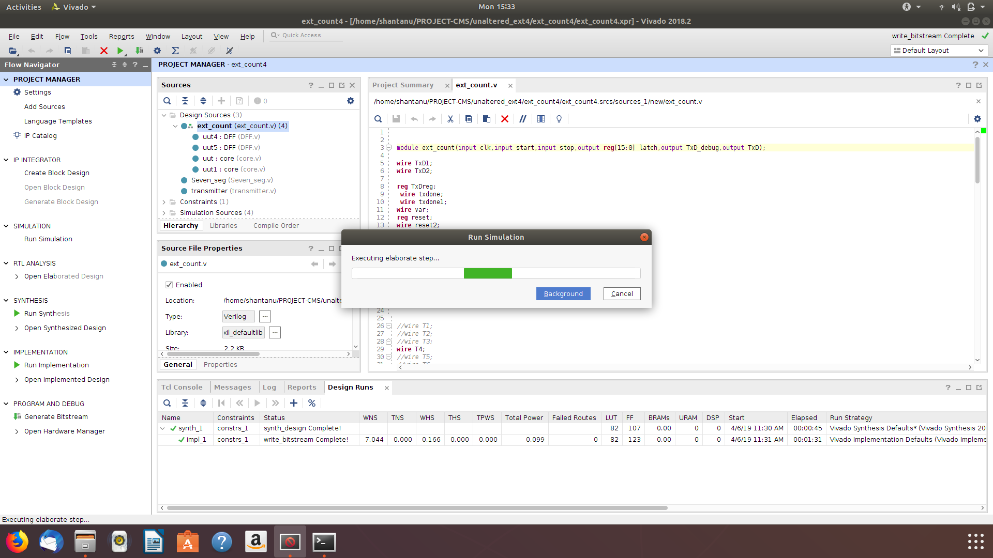
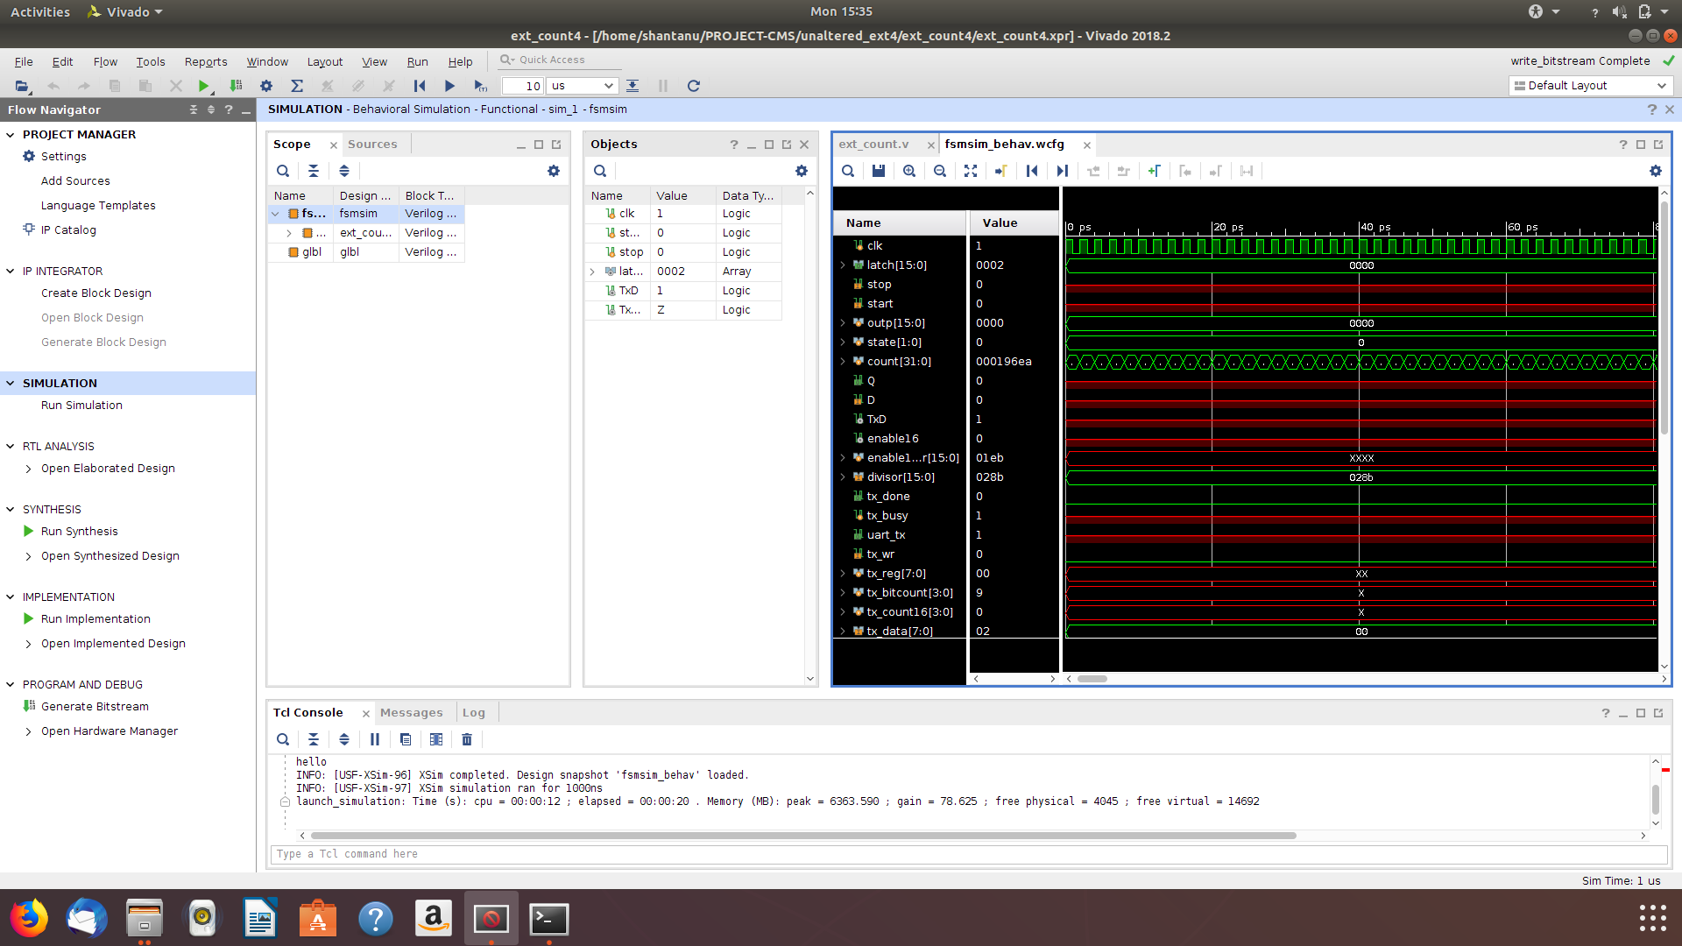
Synthesis on Vivado 2018.2

Slide 3
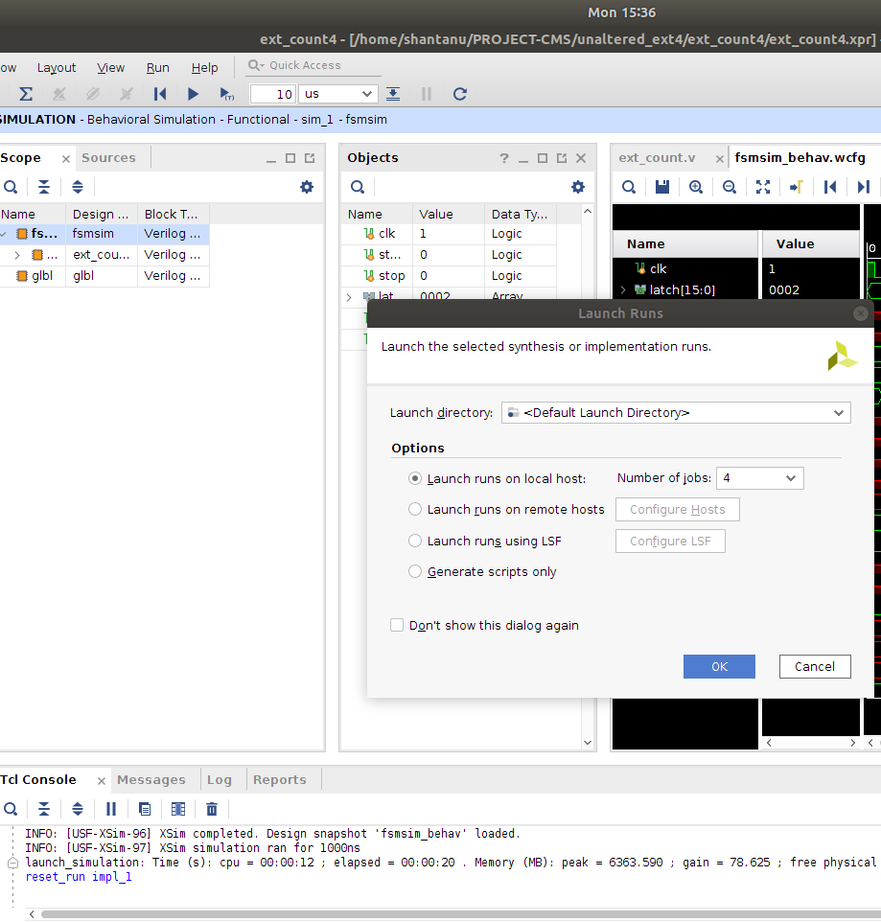
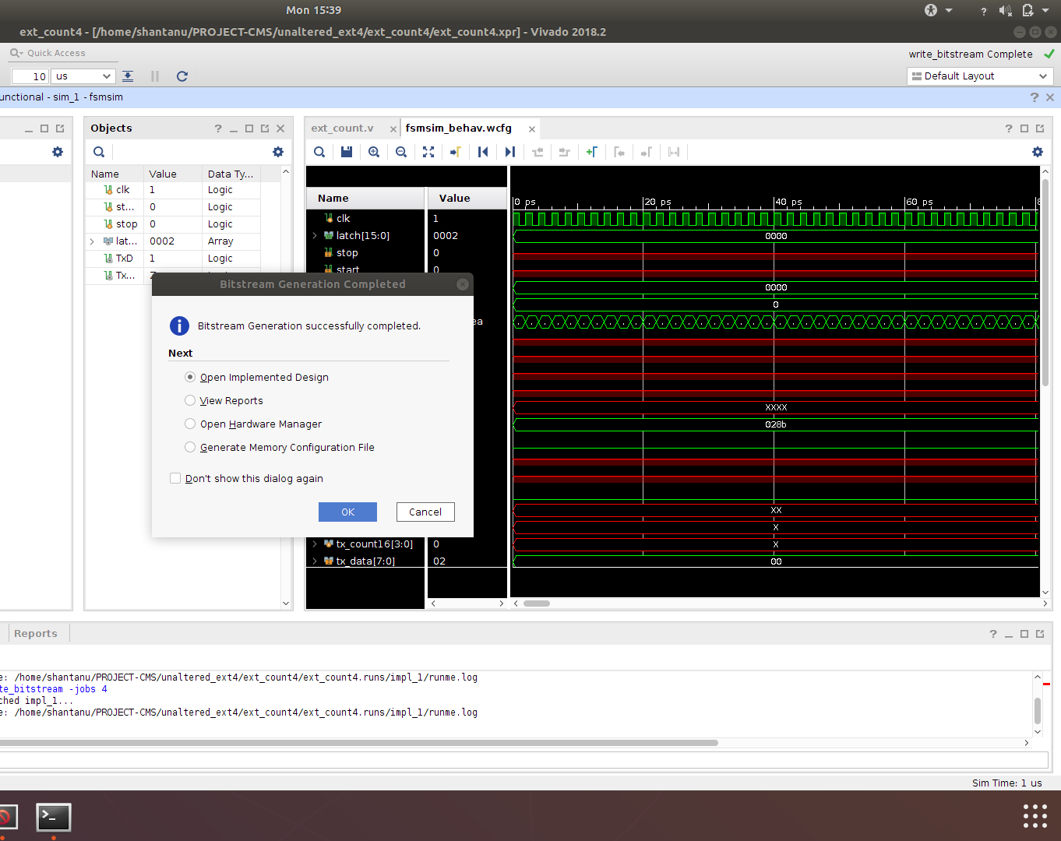
Implementation and Bit stream Generation on Vivado 2018.2

Slide 4
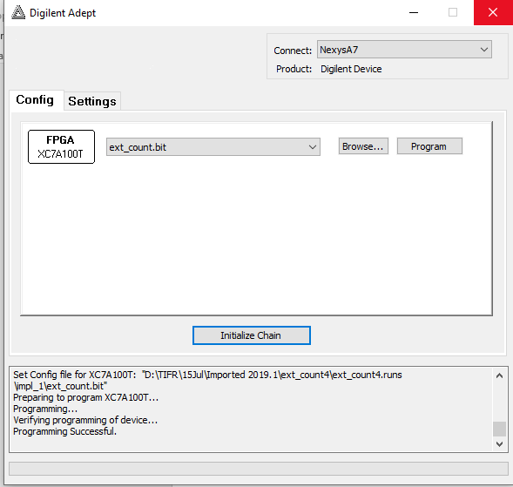
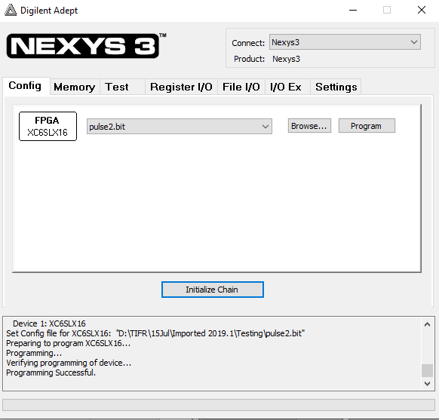
Program Output On Adept2

Slide 5
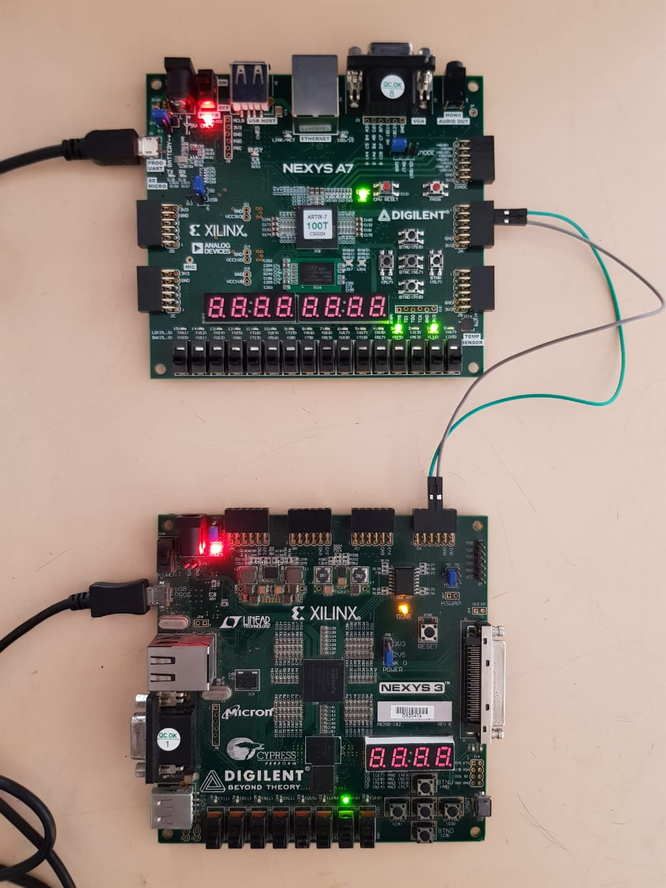
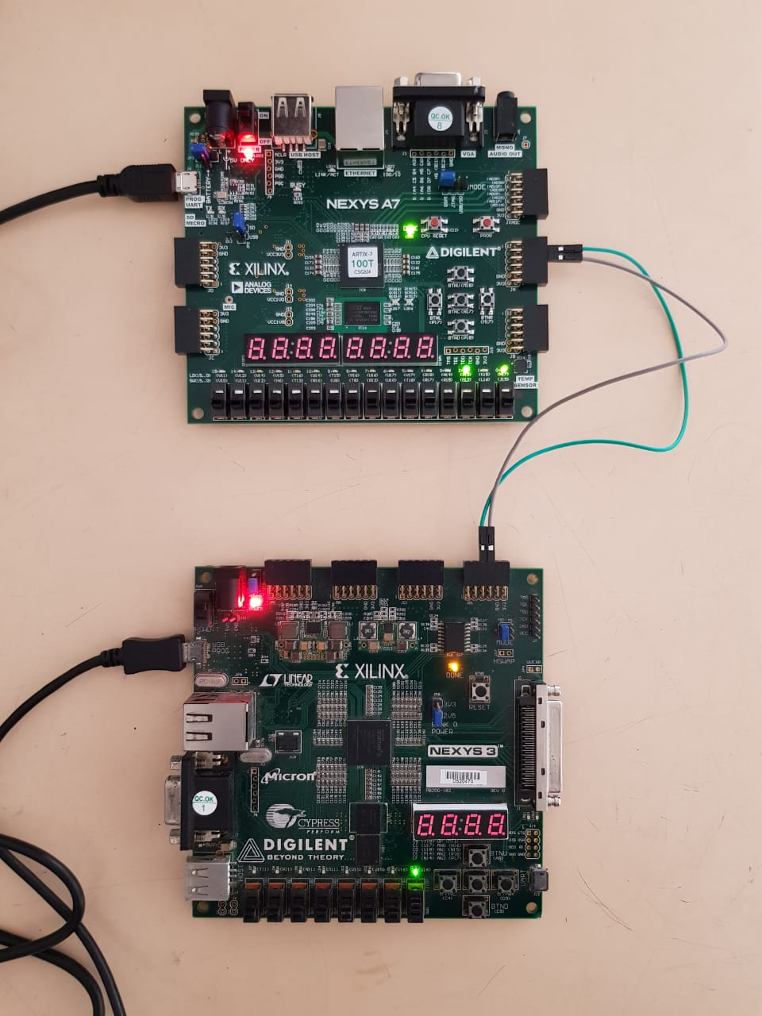
Screenshot of FPGA
Delay of 100ns
Delay of 50ns

Slide 6
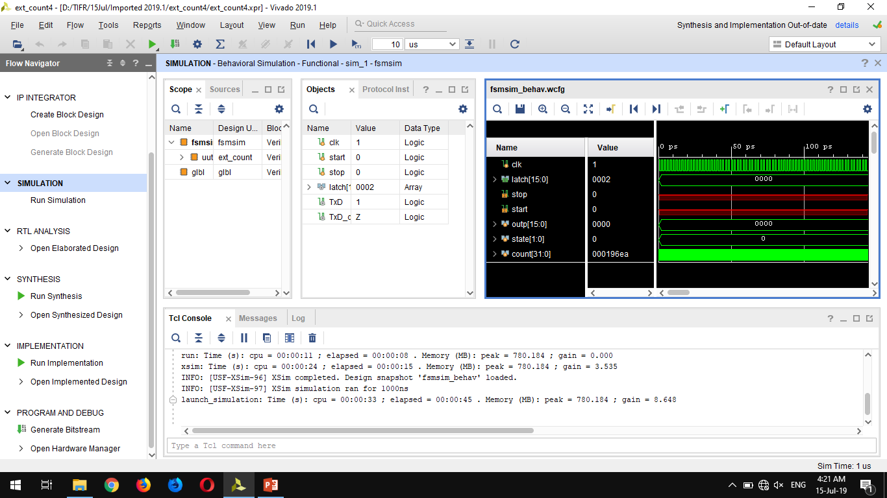
Simulation Of Project On Vivado 2019.1

Slide 7
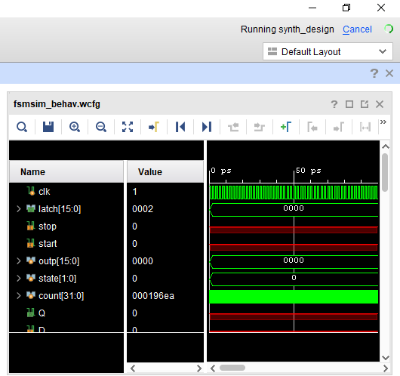
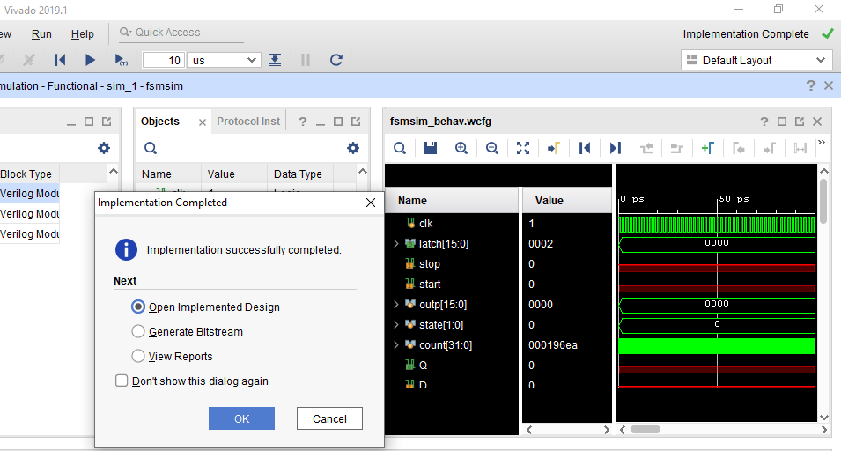
Project synthesized and implemented in Vivado 2019.1

Slide 8
Conclusions:
Project successfully runs on Vivado 2018.2 as specified in cookbook
Project successfully runs on Vivado 2019.1 on importing the project.
Proper Selection of board is important as the bit file shows incompatible if bit file is programmed on the wrong board.
“ext_count.bit” should be programmed on NexysA7
“pulse2.bit” should be programmed on Nexys3

